Slide 1
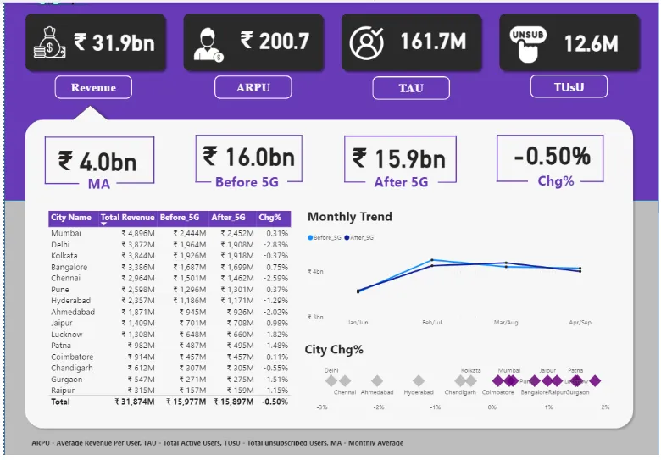
Prepared by: Name: Utkrisht Jalan Designation: Student, Fresher Course/class: B-TECH, Semester 7 Institution: Srm University Date: June 24, 2025

Slide 2
Wavecon Telecom: 5G Launch Dashboard Analysis
Executive Summary:
Total revenue: ₹31.9bn
ARPU (average revenue per user): ₹200.7
Total active users (TAU): 161.7m
Total unsubscribed users (tusu): 12.6m
Impact of 5G Launch on Revenue:
Before 5G: ₹16.0bn
After 5G: ₹15.9bn
Change: -0.50%
Insight: The launch of 5G has resulted in a slight decrease in overall revenue, with a marginal drop of 0.50% post-launch. This suggests that the anticipated revenue boost from 5G has not yet materialized at the aggregate level 1.

Slide 3
Underperforming KPI After 5G Launch: Key Underperformer : Revenue growth. Observation : Despite significant investment in 5G, revenue has declined slightly (-0.50%). This is a critical KPI that is underperforming and requires immediate attention.

Slide 4
City-Level Revenue Performance Post-5G:
City | Revenue Before 5G | Revenue After 5G | Change (%)
Mumbai | ₹2,444M | ₹2,452M | +0.31%
Delhi | ₹1,957M | ₹1,911M | -2.38%
Kolkata | ₹1,926M | ₹1,918M | -0.37%
Bangalore | ₹1,921M | ₹1,908M | -0.70%
Chennai | ₹1,715M | ₹1,701M | -0.82%
Pune | ₹1,564M | ₹1,563M | -0.09%
Hyderabad | ₹1,545M | ₹1,541M | -0.23%
Ahmedabad | ₹1,531M | ₹1,537M | +0.39%
Lucknow | ₹1,457M | ₹1,455M | -0.14%
Patna | ₹1,188M | ₹1,186M | -0.17%
Coimbatore | ₹457M | ₹457M | 0.00%
Chandigarh | ₹315M | ₹315M | 0.00%
Raipur | ₹175M | ₹175M | +0.15%
Top Performing Cities Post-5G:
Ahmedabad: +0.39%
Mumbai: +0.31%
Raipur: +0.15%
Underperforming Cities Post-5G:
Delhi: -2.38%
Chennai: -0.82%
Bangalore: -0.70%

Slide 5
Plans Most and Least Affected by 5G Launch: Most Affected (Negative Impact): Delhi: largest revenue drop (-2.38%) Chennai & Bangalore: notable declines (-0.82% and -0.70% respectively) Least Affected/Improved: Ahmedabad & Mumbai: small but positive revenue growth (+0.39% and +0.31% respectively) Coimbatore & Chandigarh: no change, indicating stability Recommendation: Continue: plans in Ahmedabad, Mumbai, and stable cities. Review/discontinue: plans in Delhi, Chennai, and Bangalore due to significant revenue drops.

Slide 6
Discontinued or At-Risk Plans Post-5G: No city shows a revenue drop to zero, indicating no plan has been fully discontinued. However, cities with significant negative change (Delhi, Chennai, Bangalore) are at risk and require strategic review. Reason for Underperformance: Possible factors: market saturation, customer churn, pricing mismatch, or inadequate 5G value proposition in these regions.

Slide 7
Recommendations: Monthly Trend: Revenue peaked in February/march and then declined, indicating a post-launch dip in momentum. Churn Risk: High number of unsubscribed users (12.6M) suggests possible dissatisfaction or migration to competitors post-5g. Action Points: Deep-dive into underperforming cities to identify root causes (pricing, network issues, customer perception). Enhance 5G marketing and customer education in lagging markets. Consider targeted offers or revised pricing in cities with negative growth. Monitor churn closely and implement retention strategies.

Slide 8
Summary Table: City Revenue Change Post-5G
City | Change (%) | Action
Ahmedabad | +0.39% | Continue
Mumbai | +0.31% | Continue
Raipur | +0.15% | Continue
Coimbatore | 0.00% | Stable
Chandigarh | 0.00% | Stable
Pune | -0.09% | Monitor
Hyderabad | -0.23% | Monitor
Lucknow | -0.14% | Monitor
Patna | -0.17% | Monitor
Kolkata | -0.37% | Review
Bangalore | -0.70% | Review/Discontinue
Chennai | -0.82% | Review/Discontinue
Delhi | -2.38% | Review/Discontinue

Slide 9
Conclusion: The 5G launch has not led to the expected revenue growth and has, in fact, resulted in a slight decline. Revenue performance varies significantly by city, with some areas showing resilience and others notable declines. No plan has been fully discontinued, but several are underperforming and should be reviewed for possible discontinuation or restructuring. Immediate focus should be on addressing underperformance in key cities and reducing churn to maximize the benefits of 5G rollout
All insights are based on the dashboard data which is given in the first slide for reference.

